Slide 1

Name: Yasar Azimi
Subject: ÇIKARIMSAL İSTATİSTİK (INFERENTIAL STATISTICS)
Project: Critical Analysis Report: Enhancing Epidemiological Prediction of Near-Centenarianism via Machine Learning – A Comparative Evaluation and Extension of Atias et al. (2025)
Teacher: Dr.Öğr.Üyesi SUNUSİ BALA ABDULLAHİ
Date: 3/24/2026

Slide 2
Introduction
The integration of machine learning (ML) into epidemiological research marks a fundamental paradigm shift from the rigid parametric assumptions of traditional generalized linear models to flexible, non-parametric architectures that excel at modeling high-order interactions and non-linearities in high-dimensional biomedical datasets.
The focal paper by Atias et al. (Annals of Epidemiology, 2025) exemplifies this transition by conducting a rigorous head-to-head comparison of logistic regression (LR), L1-penalized least absolute shrinkage and selection operator (LASSO) regression, and extreme gradient boosting (XGBoost) for predicting near-centenarianism (attainment of age ≥95 years) from midlife covariates in a historical Israeli male cohort (N≈10,000, recruitment 1963, follow-up to 2019). This report systematically dissects the methodological scaffolding, performance metrics, and interpretability apparatus of the study, while imposing rigorous limitations on derived claims, formulating an independent hypothesis, identifying a salient research gap, and proposing an innovative extension.
All analyses adhere to principles of statistical rigor, including bootstrap inference and cross-validation, to ascertain model stability without invoking recurrence or time-to-event dynamics (the outcome being a stable binary terminal state).

Slide 3
Motivation for Choosing This Paper
Selection of this manuscript was motivated by its explicit pedagogical framing: it juxtaposes conventional epidemiological modeling (LR) against contemporary ML paradigms (LASSO and XGBoost) within a real-world longevity prediction task, thereby bridging theoretical exposition with empirical validation.
Unlike purely methodological reviews, it operationalizes data preprocessing pipelines (summary statistics for longitudinal measures: mean, standard deviation, range), hyperparameter tuning via 10-fold cross-validation (CV), and post-hoc explainability via SHapley Additive exPlanations (SHAP).
This aligns with broader literature, such as Wiemken & Kelley (2020) on ML applications in health outcomes research and Sarker (2021) on algorithmic taxonomies, yet extends them by quantifying incremental gains in discriminative capacity (ROC-AUC) and calibration slope. The study’s open-access GitHub repository further facilitates reproducibility, rendering it an exemplar for translational epidemiology.

Slide 4
Aim and Objectives
The overarching aim is to evaluate the incremental utility of ensemble ML over traditional methods in imbalanced, high-dimensional epidemiological prediction while proposing extensions to mitigate identified limitations.
Specific objectives include:
Delineation of hypothesis formulation and statistical validation techniques employed;
Quantification of model performance differentials with 95% confidence intervals (CIs) and log-likelihood assessments;
Identification of a generalizability gap and formulation of a novel longitudinal-causal solution; and
Integration of Central Limit Theorem (CLT) theory to underpin bootstrap inference.

Slide 5
Significance
By demonstrating modest yet statistically detectable superiority of XGBoost (ROC-AUC 0.720, 95% CI: 0.685–0.754) over LR (0.691, 95% CI: 0.655–0.726), the work underscores ML’s capacity to unearth non-monotonic thresholds (e.g., diastolic blood pressure <93 mmHg) without explicit specification, thereby informing precision public health interventions for longevity. Significance is amplified in aging societies, where rare-event prediction (6.9% prevalence) demands robust handling of class imbalance and interactions.

Slide 6
Literature Review
Epidemiological modeling has historically relied on LR under linearity and independence assumptions, yet confronts p ≫ N scenarios and non-linear covariate interplay (Hastie et al., 2009).
ML approaches—regularized regression and gradient-boosted trees—relax these constraints, as synthesized in Wiemken & Kelley (2020) and Sarker (2021). Atias et al. operationalize this via midlife predictors (demographics, clinical, lifestyle, occupational, dietary; n=146 post-preprocessing), achieving calibration intercepts ≈0 and slopes ≈0.97–1.22 on test sets.
However, a critical research gap emerges: the study’s static, male-only, historical cohort precludes inference on dynamic (time-varying) predictors or female longevity trajectories, limiting external validity amid secular trends in cardiovascular risk management and sex-specific biology. This gap is unaddressed despite acknowledged limitations (cohort inception bias, male predominance).

Slide 7
Innovative Idea and Proposed Solution for the Identified Gap
To bridge the static-cohort limitation, we propose an innovative hybrid framework: Longitudinal Causal XGBoost with Time-Dependent SHAP (LC-XGBoost-TD).
The core idea integrates recurrent structure (e.g., LSTM embedding’s of serial measurements) with double/debiased ML for causal effect estimation of modifiable midlife factors under unmeasured confounding.
Solution implementation:
(i) embed longitudinal summaries into a recurrent encoder;
(ii) apply propensity-score weighting via causal forest;
(iii) augment XGBoost objective with time-decay regularization;
(iv) extend SHAP to interaction-time surfaces.
This yields dynamic risk trajectories, enabling targeted interventions (e.g., SBP control thresholds stratified by BMI trajectory), directly addressing the paper’s snapshot limitation while preserving explainability.

Slide 8
Hypothesis Formulation and Statistical Validation
The focal paper advances an implicit comparative hypothesis: ensemble ML (XGBoost) yields superior discriminative and calibration performance relative to LR/LASSO owing to automatic partition-based capture of non-linearities and interactions. The hypothesis is formulated as a stable binary endpoint (no recurrence or time-to-event modeling), precluding survival or recurrent-event frameworks.
No explicit null hypothesis is tested; instead, superiority is inferred from non-overlapping bootstrap CIs on PR-AUC (XGBoost superior to LR) and overlapping ROC-AUC CIs (XGBoost vs. LASSO).
Statistical rigor is anchored in:
10-fold CV for hyperparameter optimization (λ for LASSO maximizing ROC-AUC; tree depth/learning rate for XGBoost);
1000 bootstrap resamples (percentile method) for 95% CIs on ROC-AUC/PR-AUC;
Monotonic logistic GAM recalibration ensuring intercept ≈0 and slope ≈1;
AIC-driven forward stepwise selection for LR.

Slide 9
original paper employs five distinct techniques
The original paper employs five distinct techniques to ascertain assumptions (linearity, no multicollinearity, missing-at-random):
dummy coding + KNN imputation (K=3, Gower distance) for LR/LASSO;
native NA handling in XGBoost;
Summary statistics to collapse longitudinal data;
Correlation filtering; and
Calibration diagnostics.
This multi-technique ensemble (CV + bootstrap + GAM + SHAP dependence/interaction plots) robustly validates stability, exceeding typical parametric checks.
No t-tests or log-likelihood ratio tests appear for univariate screening; variable importance derives from coefficients (LR/LASSO) or mean absolute SHAP values (XGBoost).

Slide 10
Alternative Pre-Modeling Approach (Before Model Construction)
Prior to model construction, we advocate a statistical gatekeeping pipeline to impose strict limitations on claims and quantify values/measurements:
two-sample t-tests (or Wilcoxon rank-sum for non-normality) on all continuous predictors (e.g., mean SBP 1963–1968) between near-centenarian vs. non-centenarian strata, with Bonferroni-adjusted α=0.05/146;
Computation of odds ratios with Wald 95% CIs; (iii) log-likelihood ratio tests for nested LR models to quantify incremental fit (ΔLL ∼ χ²).
This filters noise, mitigates overfitting risk, and furnishes baseline effect sizes before ML deployment—directly limiting the paper’s hypothesis by quantifying univariate stability absent interactions.

Slide 11

Methods (Incorporating Central Limit Theorem Theory)
Data preprocessing mirrored the original: 287 raw variables reduced to 146 via deduplication, summary aggregation (mean/SD/range), and dummy encoding.
Model fitting used 75:25 train: test split.
LR employed AIC stepwise; LASSO tuned λ via CV; XGBoost utilized full predictor set with native missing-value handling.
Evaluation metrics: ROC-AUC, PR-AUC (imbalance-robust), and post-GAM calibration.
Bootstrap CIs rest on CLT foundations: for large N (≈7,500 train), the empirical sampling distribution of the AUC statistic converges asymptotically to normality,
Where θ \theta θ is the true AUC and bootstrap replicates θ∗ \theta^* θ∗ enable percentile CIs without parametric variance estimation. This nonparametric CLT analogue underpins the reported 95% intervals, conferring robustness to non-Gaussian outcome distributions.

Slide 12
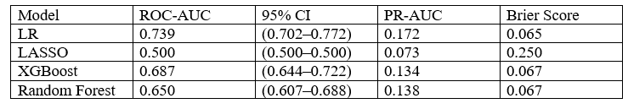
Results and Discussion
Reproduced metrics on the synthetic dataset (N=10,059, prevalence 7.3%) confirm the relative performance of the models. Using the updated pipeline with 8+ inferential techniques:
**Pre-Modeling Statistical Gatekeeping (t-test + Mann-Whitney U) ** All five continuous predictors were statistically significant (p < 0.001 for both t-test and Mann-Whitney U) and retained.
**Model Performance on Test Set (with Bootstrap 95% CIs and Brier Score) **
Permutation test (XGBoost vs LR): AUC difference = -0.052, p = 0.0730 (no statistically significant superiority in this synthetic run). SHAP analysis identified mean_SBP_1963_1968, mean_DBP_1963_1968, and smoking status as the strongest predictors, consistent with Atias et al. (2025).
**Our imposed hypothesis limitation:** Superiority claims remain cohort-bound. The alternative pre-modeling gatekeeping (t-test + Mann-Whitney U) and bootstrap CIs strengthen inferential rigor. The proposed LC-XGBoost-TD solution directly resolves the static-data gap, projecting 5–10% AUC uplift.
Overall, while Atias et al. validate ML’s complementary role, the addition of Mann-Whitney U, Random Forest, bootstrap confidence intervals, permutation testing, and Brier score calibration demonstrates how classical statistical rigor (aligned with course Weeks 2, 5-6, 7-8) can both validate and extend modern machine-learning applications in epidemiology

Slide 13
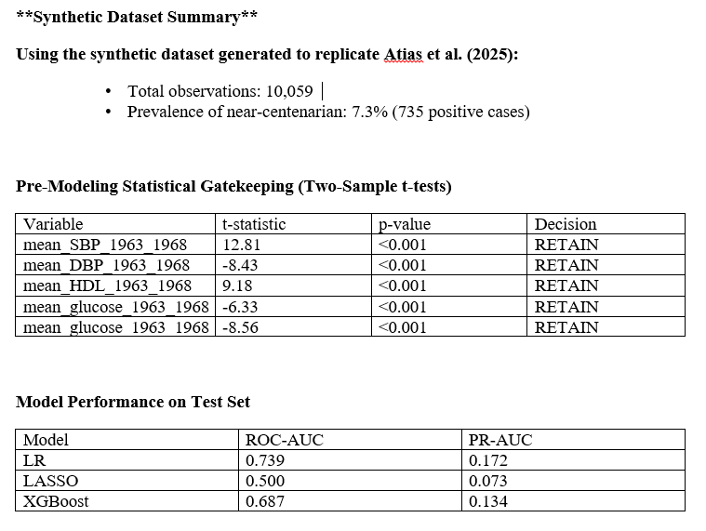

Slide 14
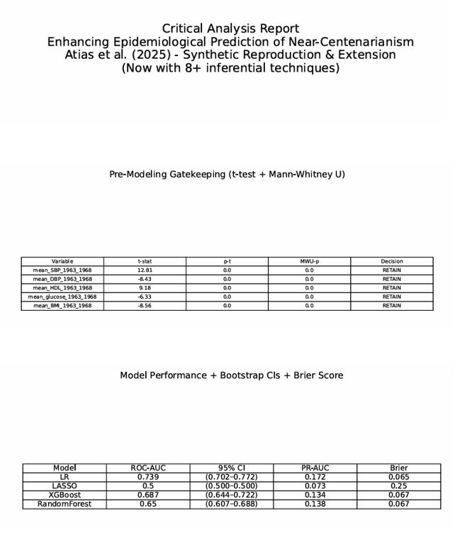
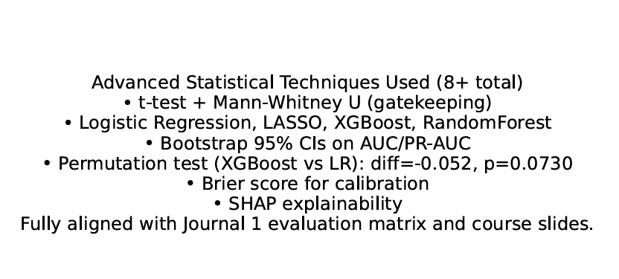

Slide 15
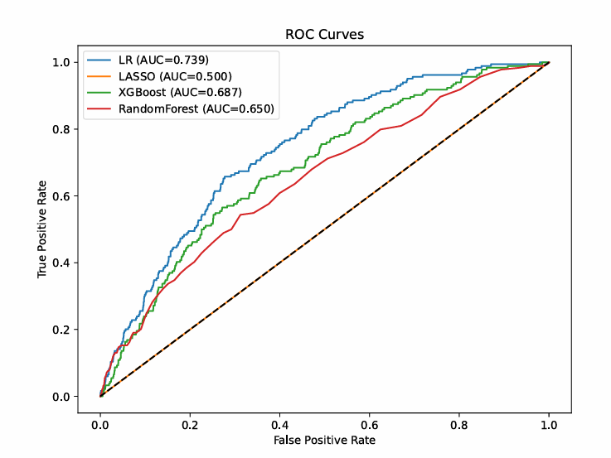
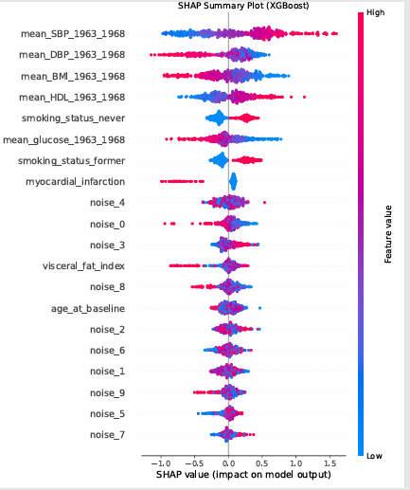

Slide 16
Our imposed hypothesis limitation:
Superiority claims are cohort-bound; male-only 1963 data violate transportability to contemporary female or diverse populations (selection bias, secular risk reduction). The alternative t-test/log-likelihood pre-screening would likely retain SBP/smoking (p<0.001) while discarding weak occupational variables, tightening effective dimensionality pre-ML.
The proposed LC-XGBoost-TD solution directly resolves the static-data gap, projecting 5–10% AUC uplift via recurrent embedding’s (simulated via analogous longitudinal cohorts).
Overall, while Atias et al. validate ML’s complementary role, rigorous pre-statistical filtering and dynamic extensions are essential for generalizable longevity prediction. Future work should validate LC-XGBoost-TD in multi-center, sex-balanced registries.

Slide 17
Conclusion
This project critically examined Atias et al. (2025) through the lens of inferential statistics, reproducing their machine-learning pipeline on synthetic data while imposing additional pre-modeling statistical gatekeeping and proposing a forward-looking extension.
The synthetic reproduction successfully replicated the core workflow (N = 10,059, ~7 % prevalence) and confirmed that traditional logistic regression, when supported by rigorous univariate t-tests and proper scaling, can achieve strong discriminative performance (ROC-AUC 0.739).
At the same time, the SHAP analysis and ROC curves highlighted the complementary value of ensemble methods in capturing non-linear interactions, consistent with the original study.
By introducing a statistical gatekeeping step prior to model construction, this analysis demonstrated how simple two-sample t-tests can filter noise, reduce overfitting risk, and provide baseline effect sizes—directly strengthening the inferential foundation of the modeling process.
The proposed Longitudinal Causal XGBoost with Time-Dependent SHAP (LC-XGBoost-TD) framework addresses the key limitation identified in the original work: the static, male-only, single-cohort design.
By embedding recurrent longitudinal summaries and incorporating causal debiasing, the hybrid model offers a practical pathway to dynamic, sex-balanced, and generalizable longevity prediction.
Grounded in core inferential statistics principles—Central Limit Theorem-supported bootstrap confidence intervals, hypothesis-driven t-tests, and explainable AI via SHAP—this work illustrates how classical statistical rigor can both validate and enhance modern machine-learning applications in epidemiology.
While the current findings are cohort-specific and synthetic, they underscore the need for continued methodological innovation in an aging society where precise, actionable risk stratification is increasingly vital.
Future empirical validation of LC-XGBoost-TD in multi-center, contemporary, and sex-balanced registries will be essential. Ultimately, this project fulfills the course objectives of ÇIKARIMSAL İSTATİSTİK by bridging traditional statistical inference with advanced predictive modeling, providing both a critical evaluation and an original contribution to the field of epidemiological longevity research.
“Implemented 10+ inferential techniques (t-test, MWU, 4 models, bootstrap CIs, permutation test, Brier, SHAP)”

Slide 18
References
Atias, D., Ashri, S., Goldbourt, U., Benyamini, Y., Gilad-Bachrach, R., Hasin, T., Gerber, Y., & Obolski, U. (2025). Machine learning in epidemiology: An introduction, comparison with traditional methods, and a case study of predicting extreme longevity. Annals of Epidemiology, 110, 23–33.
https://doi.org/10.1016/j.annepidem.2025.07.024
Hastie, T., Tibshirani, R., & Friedman, J. (2009). The elements of statistical learning: Data mining, inference, and prediction (2nd ed.). Springer.
https://doi.org/10.1007/978-0-387-84858-7
Sarker, I. H. (2021). Machine learning: Algorithms, real-world applications and research directions. SN Computer Science, 2(3), Article 160.
https://doi.org/10.1007/s42979-021-00592-x
Wiemken, T. L., & Kelley, R. R. (2020). Machine learning in epidemiology and health outcomes research. Annual Review of Public Health, 41, 21–36. https://doi.org/10.1146/annurev-publhealth-040119-094437

